Slide 1





PhDs SEMINAR From Research to Publication
01.06.18 : MODULE 3 Smart publishing
Meet & greet
Break
8:45
09:55
10:30
10:50
11:45
12:30
MODULE 4
12.06.18
don’t forget
to sign up!
Learn
Submitting your article
Learn
The peer-review models
Learn
- Negotiating your editorial contract
- CC licenses
Learn
Disseminating your article
Conclusion & questions
Practice
□ What are the most important criteria to choose a journal?
Practice
□ Play the Peer-review puzzle
Practice
□ Publisher’s contract:
welcome to hell!
Practice
□ Adopt a physicist

Slide 2


3.1 Submitting your article
Section objectives
you set your publication context: why, what and when you should publish
you know how to select the appropriate journal
you discover the key points of a cover letter
# 3.1.0

Slide 3

What could you publish? beside a traditional article
Single observation
Notebook
Video abstract/journal
Data paper
Preprint
Journals, By Barry Silver, CC-BY
# 3.1.1

Slide 4

When should you publish?
Too early premature publication
Too late beware of competitors
Alarm Clock Redux,
By Stuart B, CC-BY-NC
Our recommandations
Complete 70% of your research before publishing
Publish a short communication to mark your research territory
Present something new
Be strategic
Do not publish anything if you plan to patent
Do not split your research into too many publications to avoid «salami science»
# 3.1.2

Slide 5
Where to submit your paper?
2008-01-26 (Editing a paper) – 15 by Nic Mc Phee CC BY-SA 2.0
# 3.1.3

Slide 6
Journal typology
MEGAJOURNALS
(Open Access)
MULTIDISCIPLINARY
Nature
Science
PNAS
Scientific Reports
IEEE Access
PLoS One
DISCIPLINARY
GENERAL INTEREST
Cell
Proceedings of the IEEE
Landscape and Urban Planning
SPECIALIZED
Diabetes
Cell Stem Cell
Cities
# 3.1.4

Slide 7


Publishing business models
SUBSCRIPTION-BASED JOURNAL = “TRADITIONAL JOURNAL”
ACCESS Paying for readers
individual or institutional subscription (often through libraries)
pay-per-view
Free for authors (except for additional charges e.g color charge, length, etc.)
REUSE Authors grant exclusive rights to the publisher
DELAYED OPEN ACCESS (OA)
ACCESS Subscription-based journals providing a free online access after a period of embargo (6 to 24 months)
REUSE Authors grant exclusive rights to the publisher
HYBRID OPEN ACCESS (OA)
ACCESS Subscription-based journals providing a Gold OA option (payment of an APC) giving immediate and free access for readers
REUSE Authors retain the rights
GOLD OPEN ACCESS (OA)
ACCESS Free of charge for readers
Paying for authors
Article Processing Charge (APC)
REUSE Authors retain the rights

Slide 8
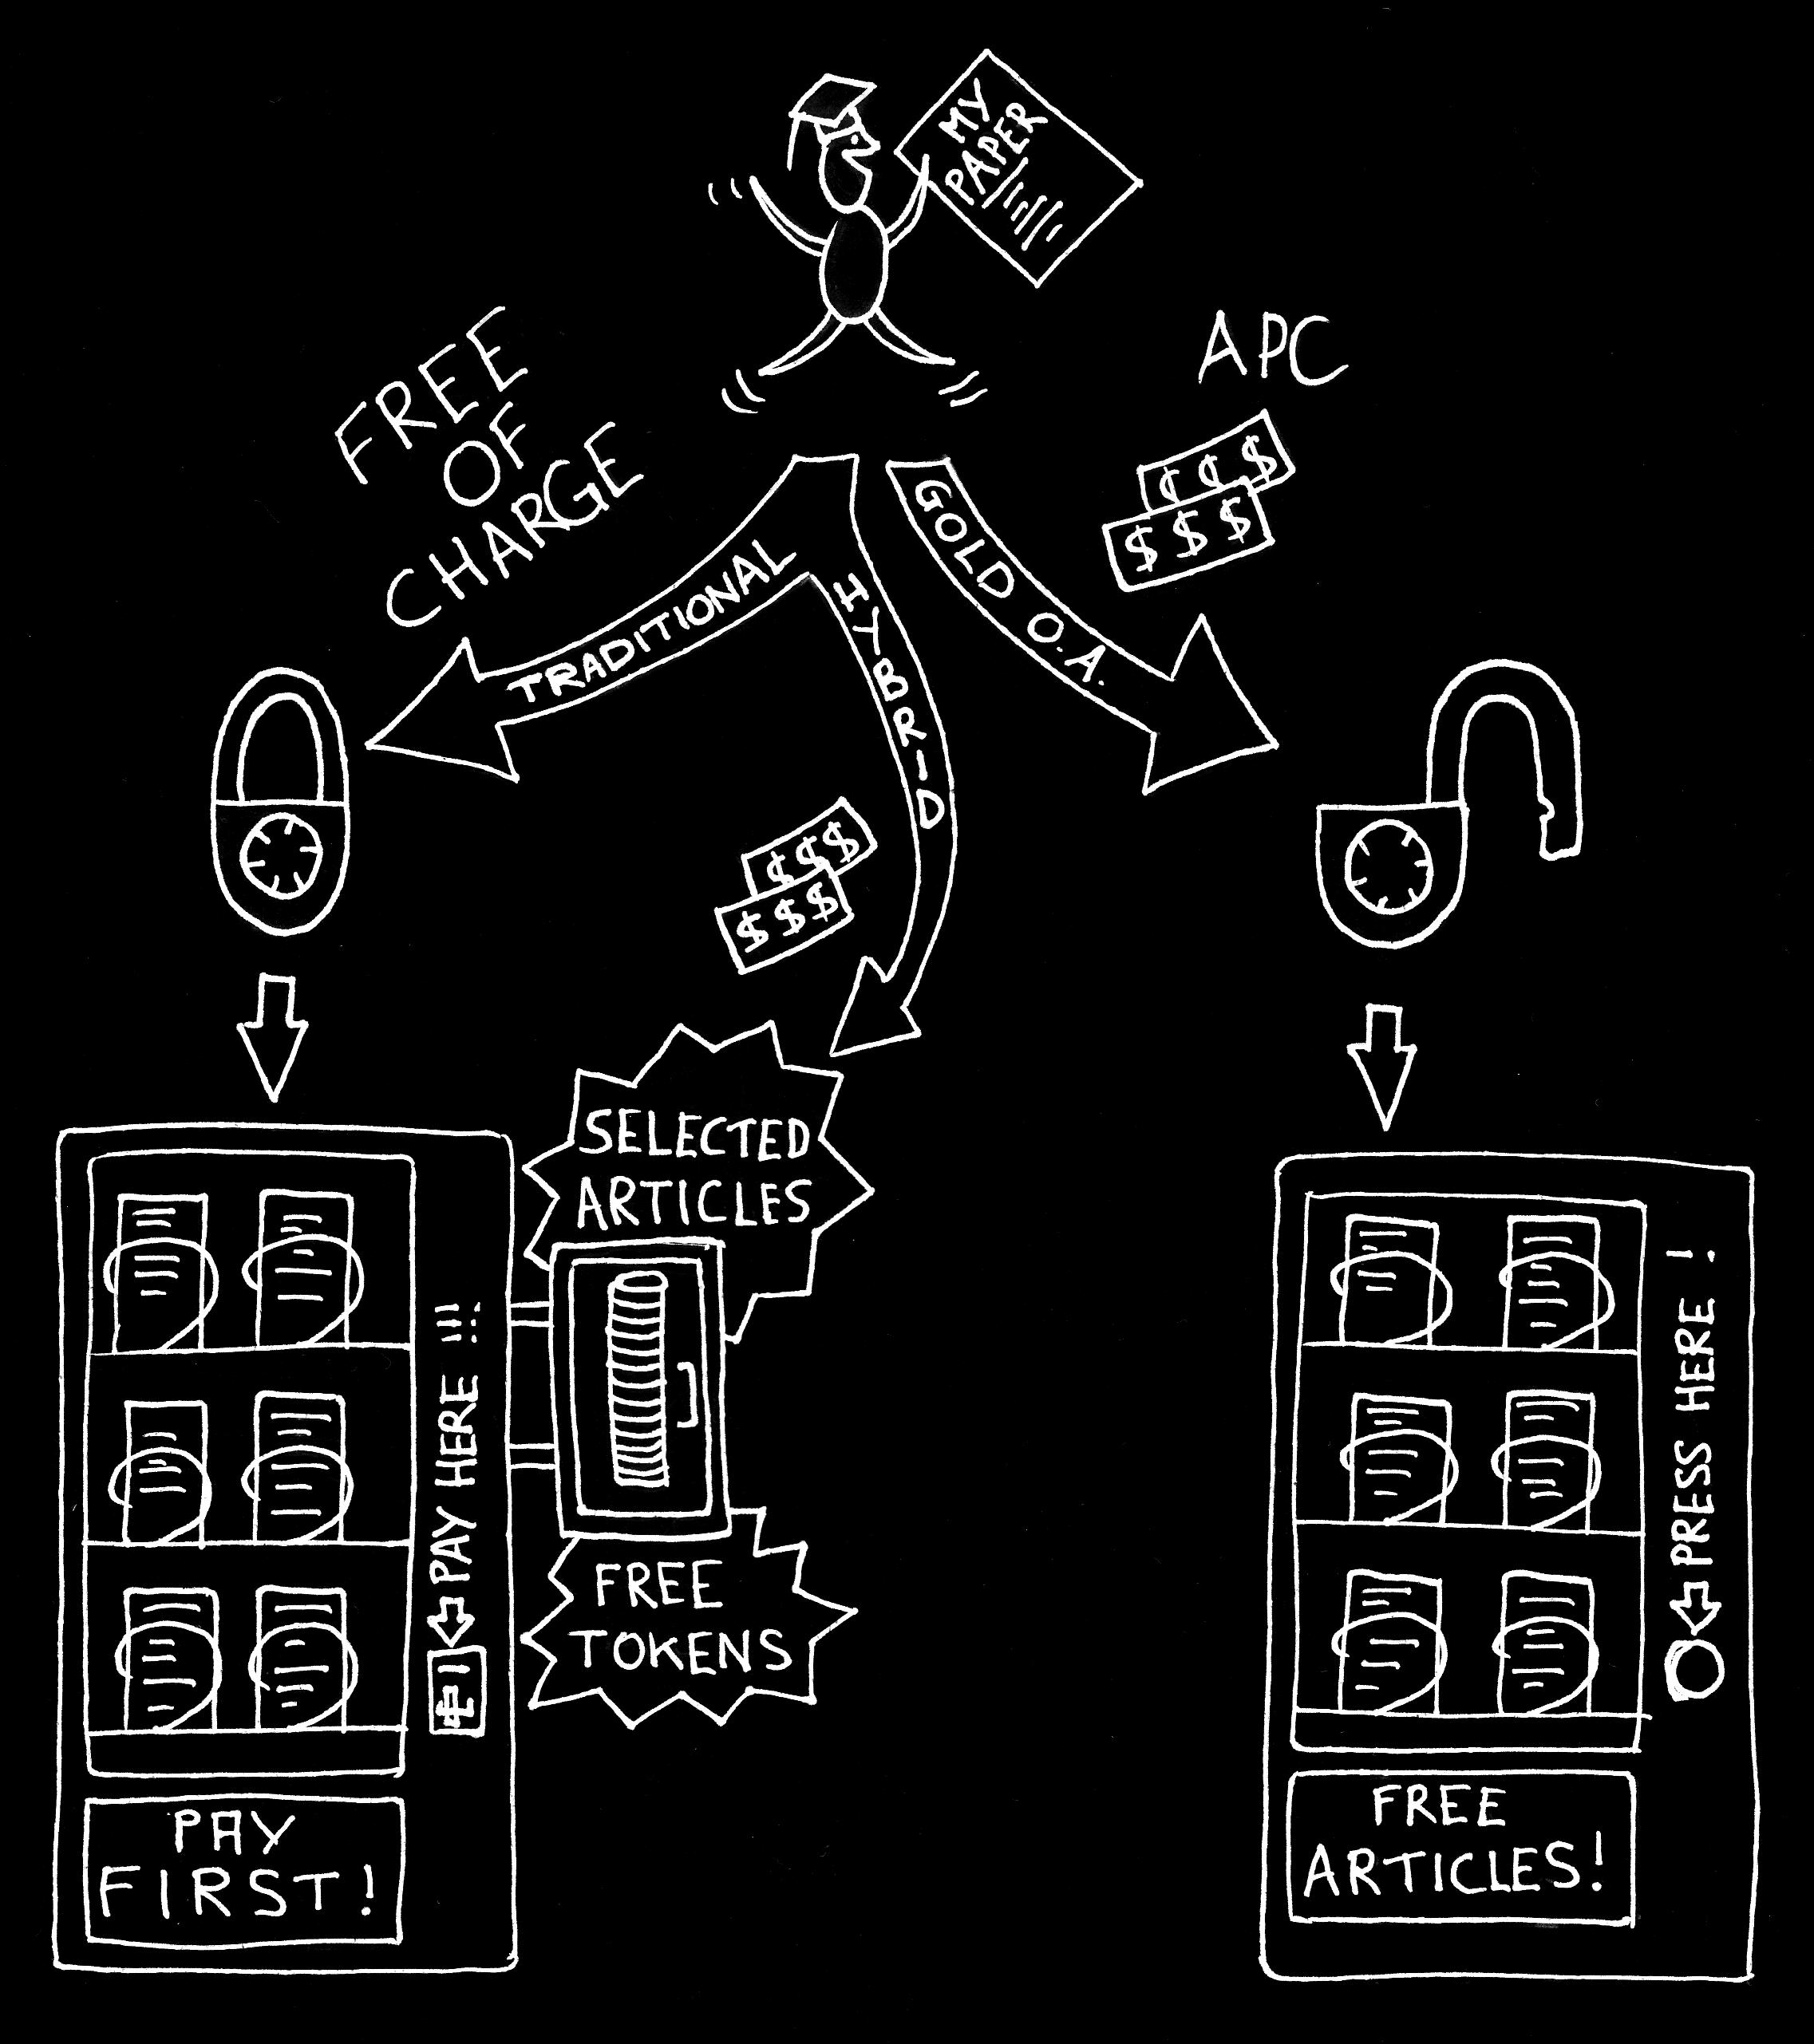
To summarize

Slide 9
“Open Access (OA) literature is digital, online, free of charge, and free of most copyright and licensing restrictions.”
(Peter Suber, 2012)

Slide 10
Publishing models by C. Fuerer CC-BY-NC

Slide 11

Green Open Access Another way to disseminate your work
PREPRINT
For author  Free deposit
For reader  Free access

Embargo
Reuse conditions
POSTPRINT

Slide 12


PLoS One
$ 1,495
Optics Express
$ 1,350
Atmospheric Chemistry
& Astrophysics
CHF 420
Nature Communications
$ 5,200
Money by Tax Credits, CC-BY 2.0
Cell Reports
$ 5,000
EMBO Molecular Medicine
$ 3,900
BMC Biology
€2,200
eLife $ 2,500
PLoS One
IF 3.1
Atmospheric Chemistry
& Astrophysics
IF 5.1
Optics Express
IF 3.2
Cell Reports
IF 7.9
Nature Communications
IF 11.3
BMC Biology
IF 7
Quality by Jason Taellious, CC-BY-ND
EMBO Molecular Medicine
IF 9.6
eLife IF 8.3
# 3.1.10
Source : Incites Journal Citation Reports – Thomson Reuters

Slide 13



Financial Support at EPFL
for Open Access publications
For full Gold Open Access (not hybrid) publications - Partial (2/3) reimbursement of the APC up to 2500.- (Limited to 2 publications per lab annually)
Agreements with some editors (PLoS, BMC, SCOAP3, Wiley, Nucleic Acids Research, etc.)
http://library.epfl.ch/OA_Support/en
publish-support.bib@epfl.ch
# 3.1.11

Slide 14
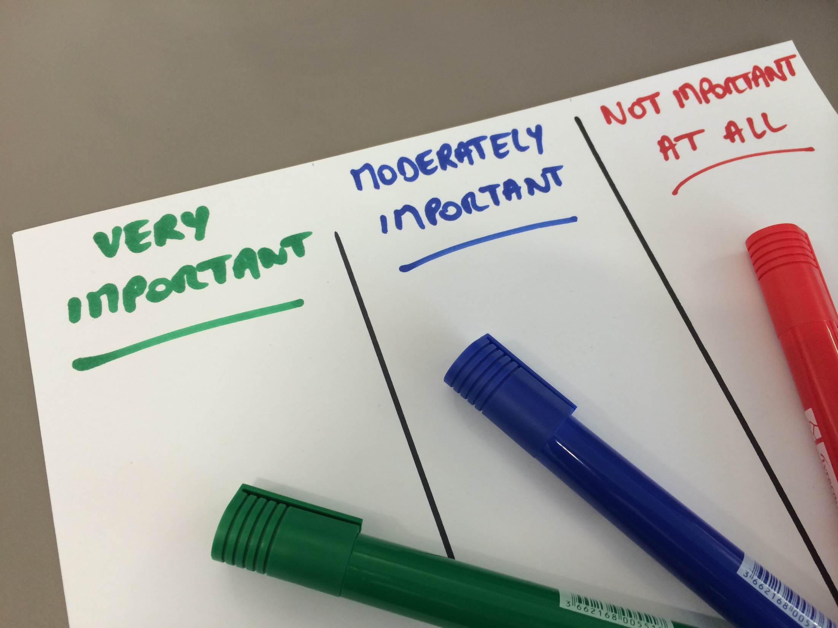
Which criteria to select a journal?
# 3.1.10

Slide 15

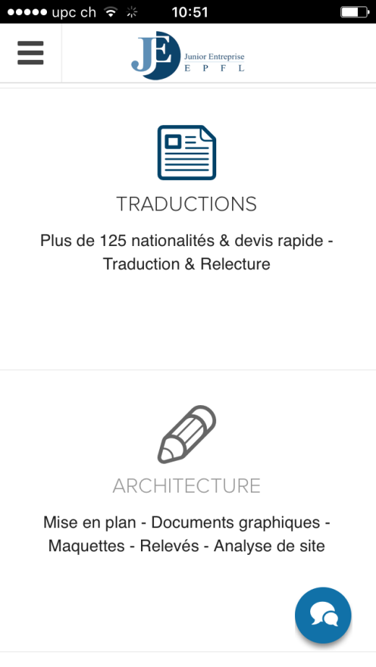
Publishing business overuse
Money by Pictures of
money, CC-BY 2.0
Publication Support Services
CAUTION
BEWARE OF PREDATORY JOURNALS
Indexing by recognized bibliographic databases
Reviewers recommendation
$300
Responses to reviewers’ comments $ on demand
Read some published articles to evaluate the quality
Cover letter writing
$50 - $80
Peer-review process clearly described
Editorial Board Members
Journal selection
$300
Fees charged clearly mentioned
Translation service at EPFL
Pre-submission - peer-review
$400
Ask your colleagues and the library
Proofreading
$120 - $200
contact: info@je-epfl.ch
# 3.1.13

Slide 16



Some journal selection tools
cofactorscience.com/journal-selector
Find a journal based on the
subject, peer review, open access and publication speed
of your paper
jane.biosemantics.org
edanzediting.com/journal-selector
Find a journal based on the
title and abstract
of your paper
Find a journal based on
keywords, field, journal name, publisher or abstract
of your paper
# 3.1.12

Slide 17

Ready to publish?
# 3.1.14

Slide 18

Before the submission
To Do List Chalkboard by Mudifah Kassalias, CC-BY-ND
Format your article  author’s guidelines
Find an appealing title and catchy keywords
Prepare an impactful cover letter
Remember that you only have one shot! Get it right!
✦
# 3.1.15

Slide 19

Cover letter
Why the paper fits the journal’s scope
Why readers would find it important
Why the paper is important for the field
Originality of the research
Convince the editor
Give a brief, largely non-technical summary
Put the work in context
Explain briefly the specific advances over previous research and potential applications
Highlight novelty and impact
# 3.1.16

Slide 20
Cover letter
Submission type (article, review, report, etc.)
Unique submission
Agreement of all co-authors
Potential conflict of interest
Co-authors contact details
History of the manuscript
Independent reviewers suggestion (or exclusion)
Other statements
Address
Directly to the Editor in Chief
# 3.1.17

Slide 21

Cover letter
Paste the abstract
Avoid typo and spelling errors
Provide the correct journal’s title and editor’s name
Use acronym and too technical terminology
Complain about previous rejection
Exceed two pages
Speak negatively about other studies or researchers
Over-interpret your findings
# 3.1.18

Slide 22
3.2 Understanding the peer review process
Section objective
you have an overall view of the traditional peer review process and its variants.
# 3.2.0

Slide 23



From preprint to final version
PREPRINT
POSTPRINT
PUBLISHER’S VERSION
Your manuscript… once submitted
Your preprint… once reviewed → accepted version
Your postprint… once laid out
●
Your content + additional content
based on the reviewers’ comments
Your content reviewed + laid out by the publisher
Your content
# 3.2.1

Slide 24

Traditional peer reviewing
SINGLE BLIND
Authors don’t know who reviewers are
Reviewers know who authors are
Editor knows who authors are
Authors
Editor
Reviewers
# 3.2.2

Slide 25
Traditional peer reviewing
DOUBLE BLIND
Authors don’t know who reviewers are
Reviewers don’t know who authors are
Editor knows who authors are
Authors
Editor
Reviewers
# 3.2.3

Slide 26
Traditional peer reviewing
TRIPLE BLIND
Authors don’t know who reviewers are
Reviewers don’t know who authors are
Editor doesn’t know who authors are
Authors
Editor
Reviewers
# 3.2.4

Slide 27
Variants: open peer review
Author – reviewers – editor are known to each other.
Article available online before the review process.
Reviewers’ reports are disclosed along the article.
Versions are available online.
Examples:
BMC Pharmacology and Toxicology
F1000 Research
# 3.2.5

Slide 28
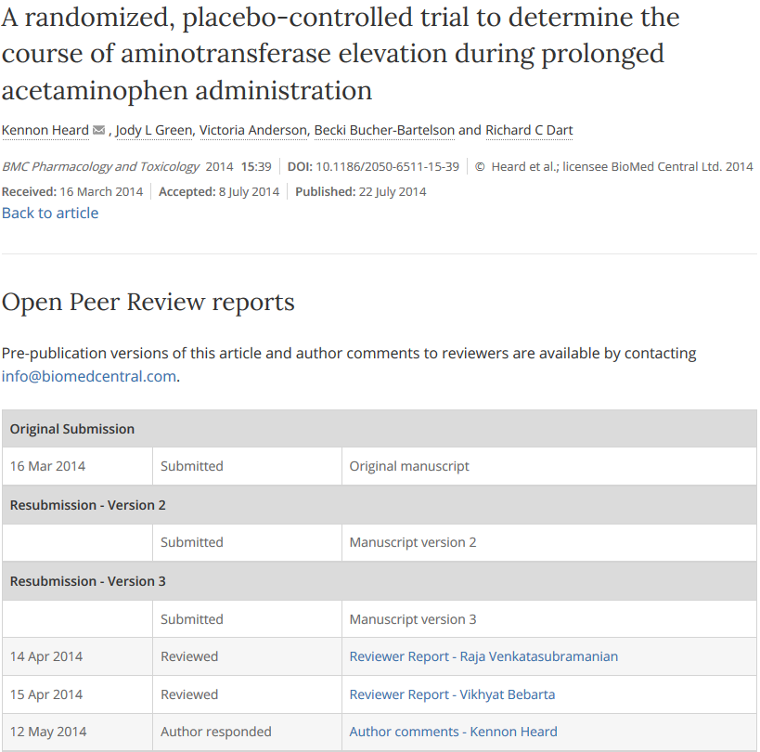
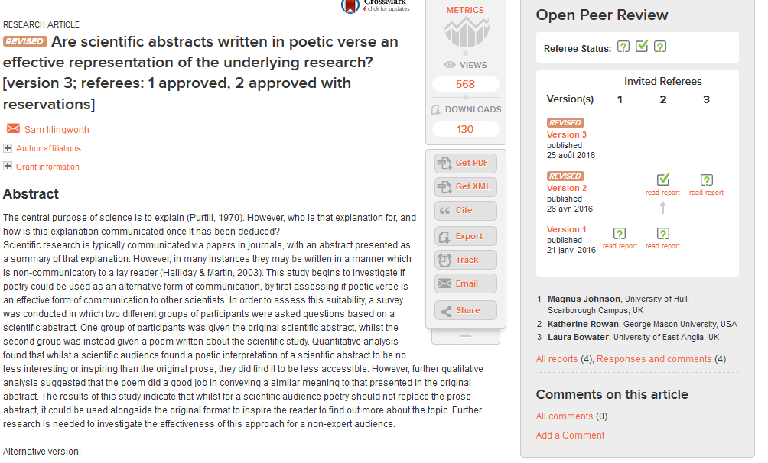
Ex.1: BMC Pharmacology and Toxicology
Ex.2: F1000 Research
# 3.2.6

Slide 29
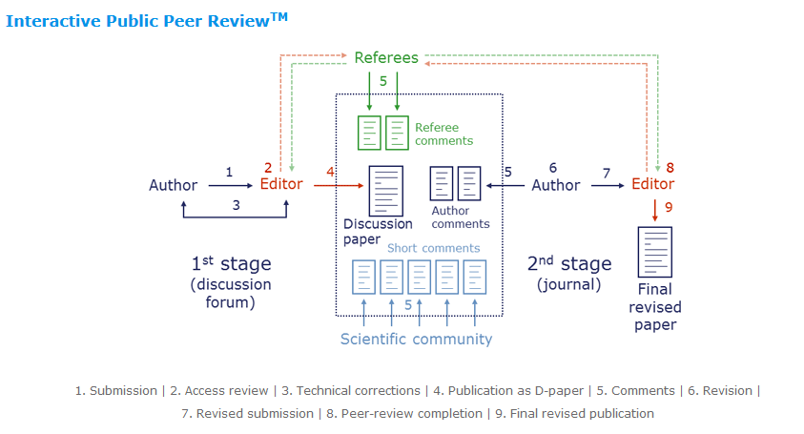
Variants: interactive peer review
Public commenting online
Ex.3: Atmospheric Chemistry and Physics
# 3.2.7

Slide 30
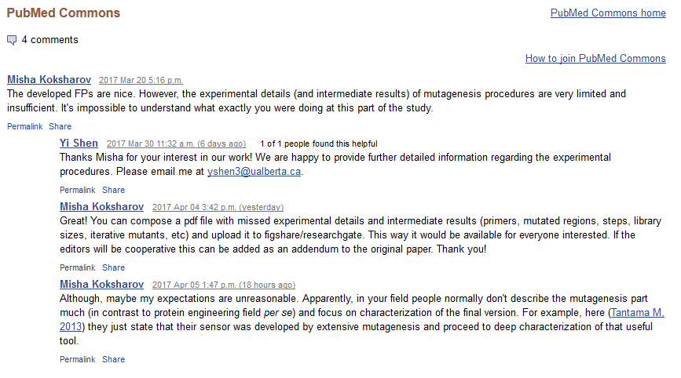
Variants: post-publication review
Quicker and more efficient?
Ex.4: PubMed Commons
# 3.2.8

Slide 31

Peer review – recap & perspectives
Remember that…
there are many ways to perform peer review:
before and/or after online publication
with various levels of anonymity
with named referees or the online community
What comes next?
No more publishers? Trish Groves, BMJ Open
???
# 3.2.9

Slide 32




The peer review process
START
8
STEP 1
7
STEP 8
STEP 9
1
STEP 7
9
2B
10 C
10 A
STEP 2
DEAD END
6
STEP 6
STEP 10
DEAD END
2A
10 B
5A
STEP 3
STEP 4
STEP 5
STEP 11
STEP 12
3
4
5C
11
12
5B
DEAD END
HAPPY
END
# 3.2.10

Slide 33

The peer review process
START
8
AUTHOR
7
Sends the
revised MS
to reviewers
REVIEWER
Reads the revised MS
+ writes
review report
EDITOR
1
Submits the manuscript
(MS abbrev.)
EDITOR
Assesses reviews
9
2B
10 C
10 A
EDITOR
Rejects without review
DEAD END
6
Submits the
revised MS
AUTHOR
Sends reviews
+ asks for
additional revisions
EDITOR
Sends reviews
+ rejects the
revised MS
DEAD END
2A
Sends out the MS
for review
Sends reviews
+ asks for
a first round of revisions
Sends reviews
+ accepts
the paper for publication
10 B
5A
REVIEWER
Reads the MS
+ writes
review report
EDITOR
Assesses reviews
EDITOR
Sends reviews + accepts
the paper for publication
JOURNAL PRODUCTION
DPT
Prepares proofs for authors
JOURNAL
PRODUCTION
DPT
3
4
Sends reviews
+ rejects or
encourages
resubmission
5C
11
Publishes
the final version
12
5B
DEAD END
HAPPY
END
# 3.2.11

Slide 34
Reasons for REJECTION
Inappropriate scope and audience
Incorrect formatting
“Salami” science
Flaws in methodology
Inadequate literature citation
Lack of novelty
Conclusion not supported by the data
(Self-)Plagiarism
Text + Image
Limited impact and urgency
Research data not available
Lack of interpretations
Premature publication
# 3.2.12

Slide 35
3.3 Negotiating your contract
Section objective
you discover tools to negotiate an editorial contract.
# 3.3.0

Slide 36
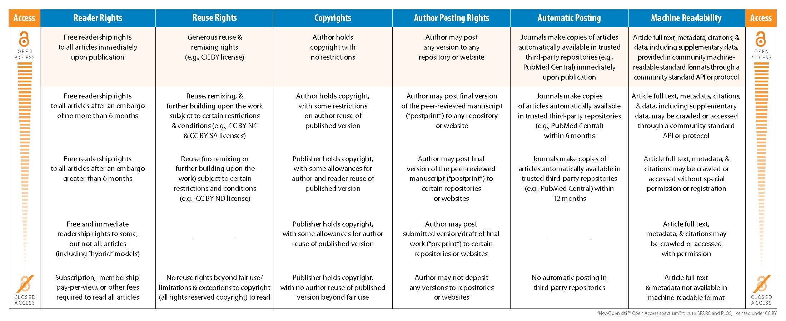
How Open Is It?
# 3.3.2

Slide 37
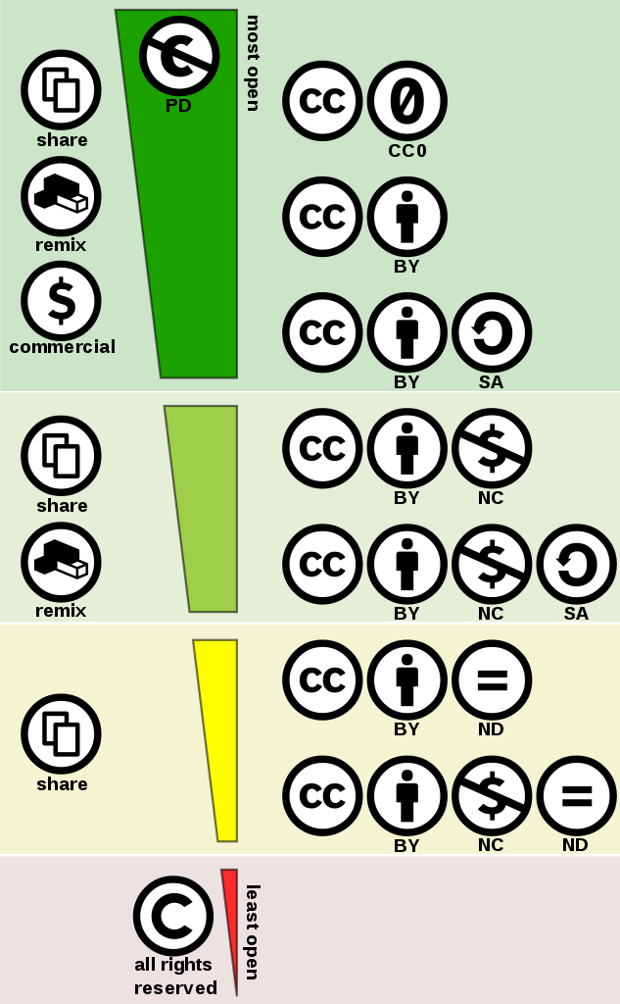
public domain equivalent [freely reusable]
free [reusable]
open [not always reusable]
closed [not reusable at all]
# 3.3.1

Slide 38
Publisher’s contract
WELCOME TO HELL!

Slide 39
Activity
> Work in groups
> Read one of the publisher’s contracts
> Answer to the following questions:
1. Do you own the rights?
2. Do you have the right to reuse the article?
3. Has the reader the right to reuse the article?
4. Do you have the right to post the article?
# 3.3.4

Slide 40
3.4 Disseminating your article
Section objectives
you understand what bibliometrics really is
you understand what bibliometrics is used for
you know how to create a dissemination strategy
# 3.4.0

Slide 41
Impact Factor
Are you a good researcher
if you publish in a top journal?
Nature | art. publ. | cited in 2014
2013 | 860 | 29,753
2012 | 869 | 41,924
TOTAL | 1,729 | 71,677
IF₂₀₁₄ = | 71,677 | = 41.456
 | 1,729
The case of ACTA CRYSTALLOGRAPHICA SECTION A (2009-2010):
http://go.epfl.ch/aca-if (webpage accessible from EPFL)
# 3.4.1

Slide 42
h-index
The h-index (named after Jorge Hirsch) is based on the database of your choice.
The h of the h-index (named after Jorge Hirsch) means that
a researcher has published h articles
that have been cited at least h times.
# citations
h-index = 5
5 citations
The h-index is sometimes used for journals.
Can also be used for a lab.
paper rank
5th rank
# 3.4.2

Slide 43
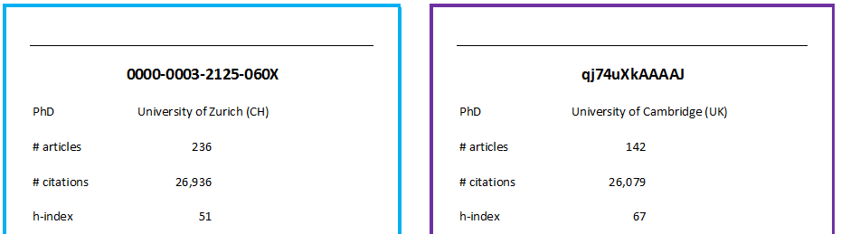
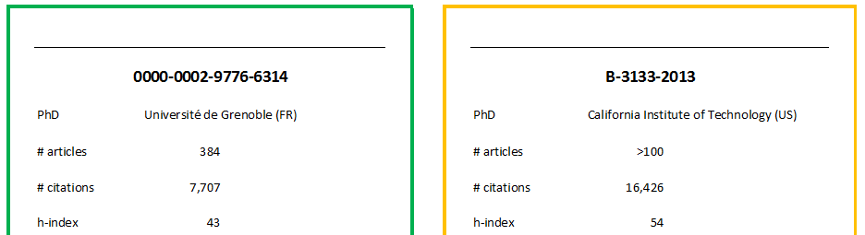
Adopt a physicist
You have to choose a researcher for an open position in the Physics section. You have 4 candidates left.
What is your choice?
# 3.4.3

Slide 44
Metrics…
Is a paper good because it was published in a top journal?
Is a paper good because the author is a good researcher?
JOURNAL-LEVEL
METRICS
ARTICLE-LEVEL
METRICS
(ALM)
AUTHOR-LEVEL
METRICS
Impact Factor
altmetrics
h-index
SJR Indicator
# 3.4.4

Slide 45
altmetrics
Unlike other metrics, altmetrics don’t rely on citations only.
Altmetrics take social actions like views, saves, posts and comments as well as citations in account to measure the influence of an article on the scientific community.
views and downloads
on the journal website
(or another platform)
posts and comments
on scientific blogs, Twitter, Facebook…
reference saved
in Mendeley
(or another reference manager)
Be aware that altmetrics are not computed the same way by all providers!
# 3.4.5

Slide 46
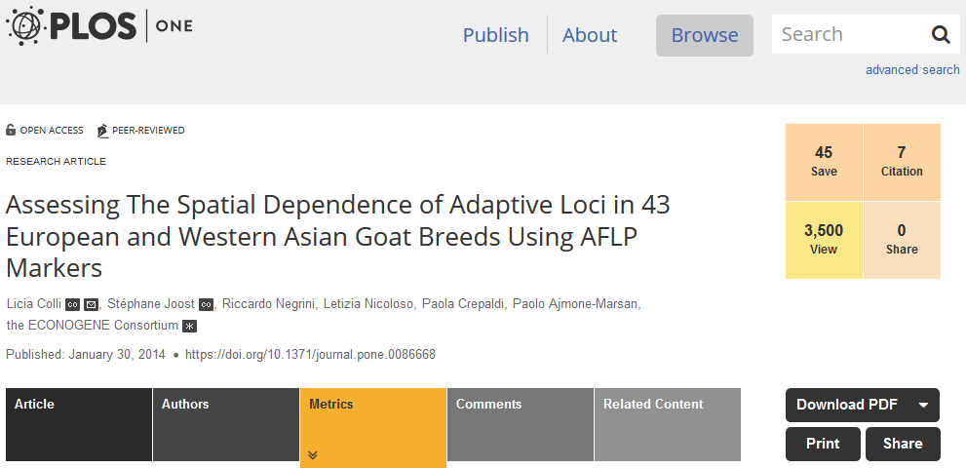
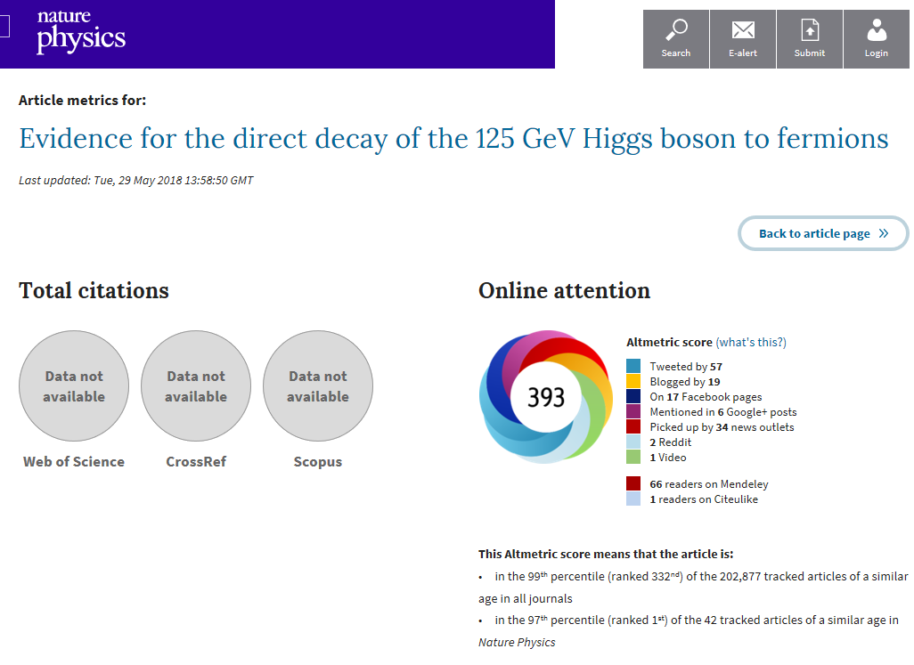
altmetrics
PLoS ONE
Nature Physics
DOI: 10.1371/journal.pone.0086668
DOI: 10.1038/nphys3005
# 3.4.6

Slide 47

How could you (ethically) increase the visibility of your paper ??
Draw in color... I mostly draw with orange.... by Bernat Casero CC BY-NC-ND
You published an excellent article last year.
But, for now, it hasn’t received many citations…

Slide 48
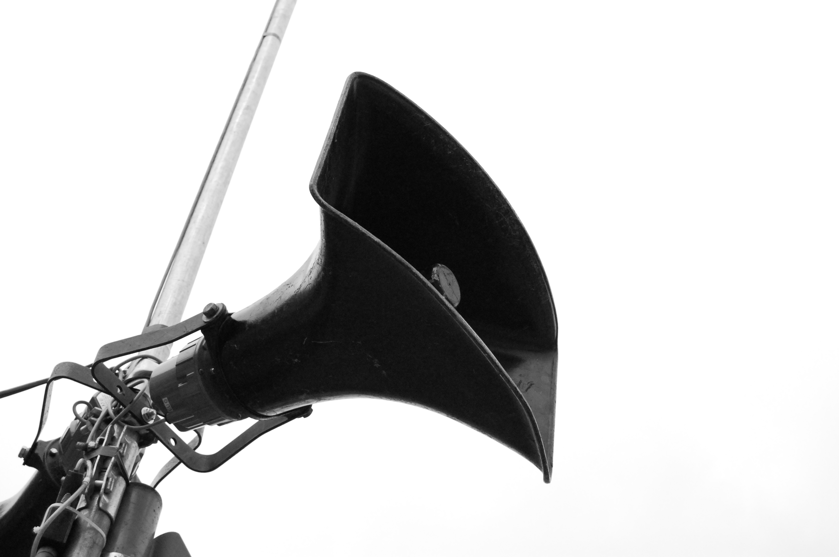
Loudpseaker by Rusty Sheriff CC BY-NC
Present your work in conferences
Mention your paper on Twitter
Cite your paper in further publications**
Deposit your paper in INFOSCIENCE*
Disseminate the news through EPFL channels
Add your paper on academic social networks*
Share your datasets
Talk about your paper in your blog
# 3.4.8
* within the limits of your contract **when relevant

Slide 49


STAY TUNED!
Next trainings
PhD seminars – From research to publication
Module 4: Research Data Management – June 12
To register: https://library.epfl.ch/training-phd/en
Workshop by CAPE & Library
Stay away from plagiarism – June 15
To register: https://bookwhen.com/fr/cape
Mintt course: Management of Innovation and Technology Transfer
IR rights elaboration, license negotiation and more
To register: https://mintt.epfl.ch/
(Full. Next session will be announced in early 2019)

Slide 50
SMART PUBLISHING
Further readings
HAMES, Irene, 2007, Peer review and manuscript management in scientific journals : guidelines for good practice. Malden, Mass : Blackwell. ISBN 978-1-4051-3159-9.
PRIEM, Jason, TARABORELLI, Dario, GROTH, Paul and NEYLON, Cameron, 2011, Altmetrics: a manifesto. Altmetrics [online]. 28 September 2011. [Accessed 15 March 2016]. Available from: http://altmetrics.org/manifesto/
SCHOLARLY PUBLISHING AND ACADEMIC RESOURCES COALITION, 2007, Author Rights & the SPARC Author Addendum. SPARC [online]. 2016 2007. [Accessed 14 March 2016]. Available from: http://sparcopen.org/our-work/author-rights/#background
SENSE ABOUT SCIENCE, 2012, 3: Peer Review: The Nuts and Bolts [online]. London : Sense About Science. [Accessed 15 March 2016]. Standing up for Science. Available from: http://www.senseaboutscience.org/data/files/resources/99/Peer-review_The-nuts-and-bolts.pdf
THROWER, Peter, 2012, Eight reasons I rejected your article: A journal editor reveals the top reasons so many manuscripts don’t make it to the peer review process. Elsevier Connect [online]. 12 September 2012. [Accessed 15 March 2016]. Available from: https://www.elsevier.com/connect/8-reasons-i-rejected-your-article
This bibliography is regularly updated: go.epfl.ch/SmartPublishing
# 3.X.1

Slide 51





SMART PUBLISHING
Smart Publishing by EPFL Library (2017)
Library Training Team
Caroline Salamin
Mathilde Panes
Noémi Cobolet
Raphaël Grolimund
formations.bib@epfl.ch
library.epfl.ch
facebook.com/EPFL.library
youtube.com/epfllibrary
@EPFLlibrary
Open Access Service at EPFL Library
Béatrice Marselli
publish-support.bib@epfl.ch
# 3.X.2

Slide 52








SMART PUBLISHING
Credits
These course notes reuse icons published under CC BY 3.0 license on thenounproject.com:
Copy by Iulia Ardeleanu
Article management by Havhannes Fahradyan
Newspaper by Julynn B.
Closed eye by Samarin Nikita
Eye by To Uyen
Checkered Flag by Samy Menai
Loop by ChangHoon Baek
Trophy by To Uyen
Bones by Brian Oppenlander
Box by Chameleon Design
Peer-review, by AJC1, CC-BY-SA
# 3.X.3

